Slide 1
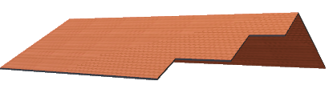
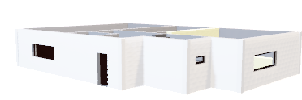
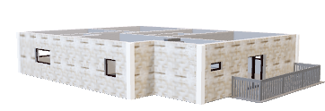
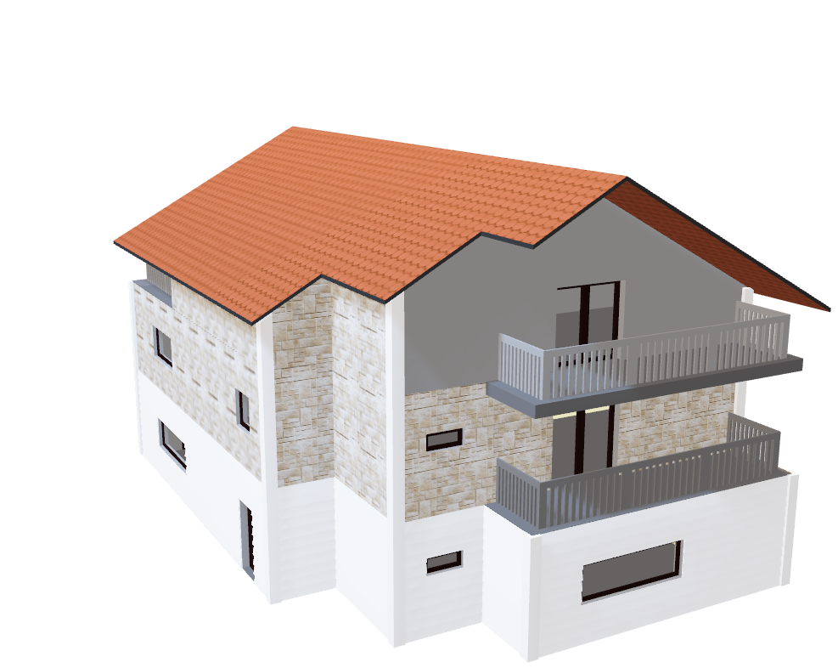
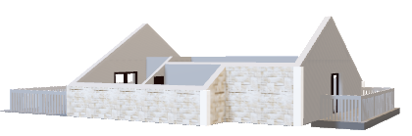
Amitava Samaddar, Prem Ganesh & Suvrangshu Ghosh PRESENTS: THE ULTIMATE HOUSE PRICE PREDICTOR
In a world where home price plays a major role in economy, government & individuals, it’s essential that an accurate prediction is required.
THE ULTIMATE HOUSE PRICE
PREDICTOR
Designed to make the most accurate predictions using more than 70 features and multiple supervised Machine Learning algorithms

Slide 2

THE ULTIMATE HOUSE PRICE PREDICTOR
Real estate appraisal is a challenging multidimensional problem that involves estimating many facets of a property, its neighborhood, and its city.
In the real estate market, professional appraisers use Multiple Listing Services (MLS) to estimate prices from similar recently sold properties within the same market area.
The recent years have seen the advent of new sources of data and new methods, mainly coming from machine learning to predict house prices more accurately.
We used data from Kaggle.com dataset
https://www.kaggle.com/c/house-prices-advanced-regression-techniques

Slide 3
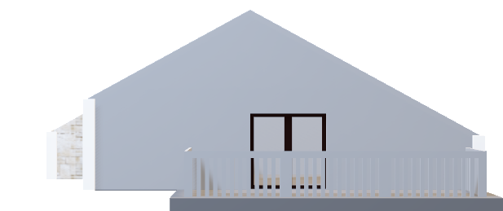
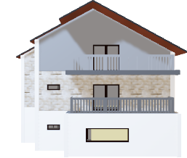

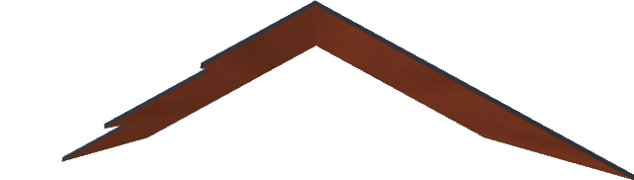
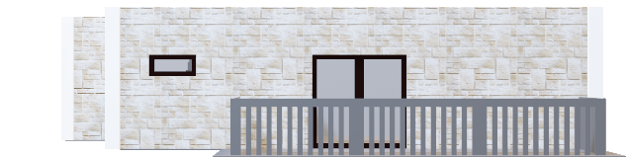
SIDE
ROOF:
Modeling and Predictions using Random Forest Regressor
KNN Regressor
Understanding the data
Improving the Skewness and Kurtosis
Categorical and Numerical data analysis
Plot missing values
Identify most important features
Multivariable data plotting
Cleanup missing values
Convert categorical to numerical
Create Training set
Execute various regression models:
Random Forest Regressor
KNN Regressor
Predict home price
3rd FLOOR:
Transformation/Engineering, Data cleanup, missing values, Plotting, Correlation matrix, convert categorical columns to numerical
2nd FLOOR:
Multivariable Analysis
Numerical and Categorical features Analysis, Plotting
1st FLOOR:
Loading data and analyse data skewness

Slide 4
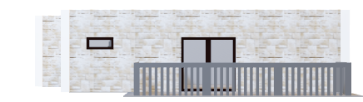


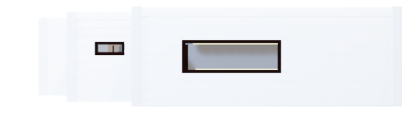
The Process
ROOF:
Modeling and Predictions using Random Forest Regressor
KNN Regressor
Understanding the data
Improving the Skewness and Kurtosis
Categorical and Numerical data analysis
Plot missing values
Identify most important features
Multivariable data plotting
Cleanup missing values
Convert categorical to numerical
Create Training set
Execute various regression models:
Random Forest Regressor
KNN Regressor
Predict home price
3rd FLOOR:
Transformation/Engineering, , Data cleanup, missing values, Plotting, Correlation matrix, convert categorical columns to numerical
2nd FLOOR:
Multivariable Analysis
Numerical and Categorical features Analysis, Plotting
1st FLOOR:
Loading data and analyse data skewness

Slide 5
Understanding the data
Dataset has 79 columns/ many characteristics define price value
Id | MSSubClass | MSZoning | LotFrontage | LotArea | Street | Alley | LotShape | LandContour | Utilities
LotConfig | LandSlope | Neighborhood | Condition1 | Condition2 | BldgType | HouseStyle | OverallQual | OverallCond | YearBuilt
YearRemodAdd | RoofStyle | RoofMatl | Exterior1st | Exterior2nd | MasVnrType | MasVnrArea | ExterQual | ExterCond | Foundation
BsmtQual | BsmtCond | BsmtExposure | BsmtFinType1 | BsmtFinSF1 | BsmtFinType2 | BsmtFinSF2 | BsmtUnfSF | TotalBsmtSF | Heating
HeatingQC | CentralAir | Electrical | 1stFlrSF | 2ndFlrSF | LowQualFinSF | GrLivArea | BsmtFullBath | BsmtHalfBath | FullBath
HalfBath | BedroomAbvGr | KitchenAbvGr | KitchenQual | TotRmsAbvGrd | Functional | Fireplaces | FireplaceQu | GarageType | GarageYrBlt
GarageFinish | GarageCars | GarageArea | GarageQual | GarageCond | PavedDrive | WoodDeckSF | OpenPorchSF | EnclosedPorch | 3SsnPorch
ScreenPorch | PoolArea | PoolQC | Fence | MiscFeature | MiscVal | MoSold | YrSold | SaleType | SaleCondition

Slide 6
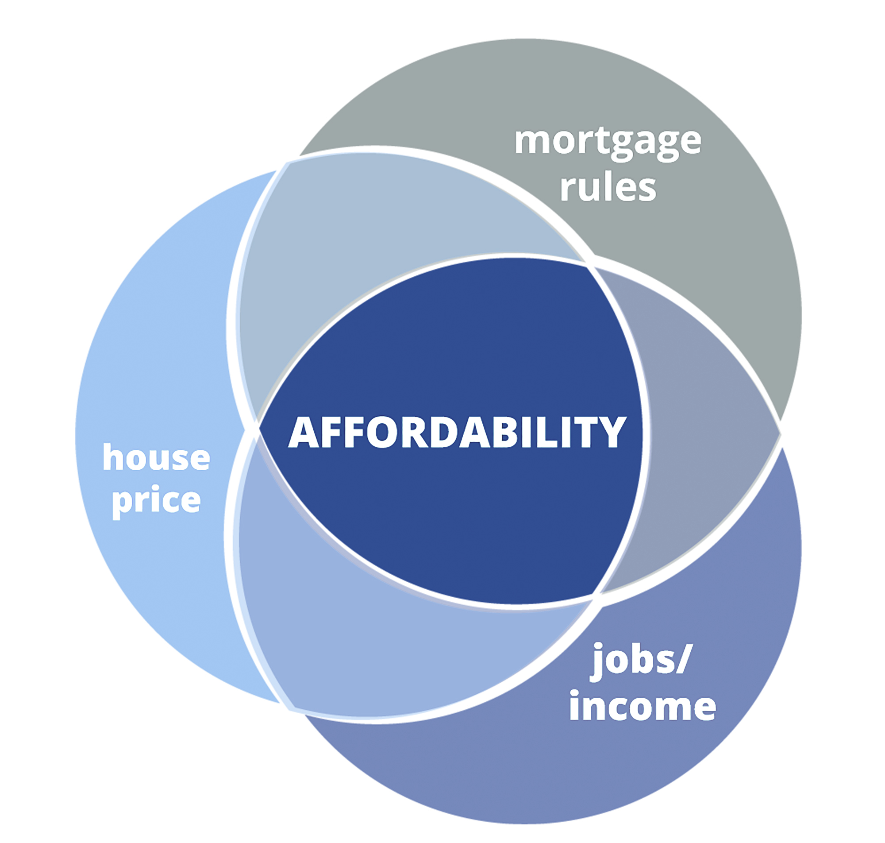
Missing links
Besides these 70+ factors, there are a few important factors which also effects the price

Slide 7
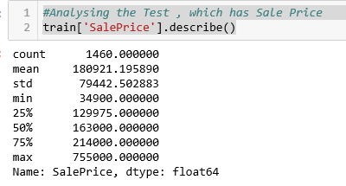
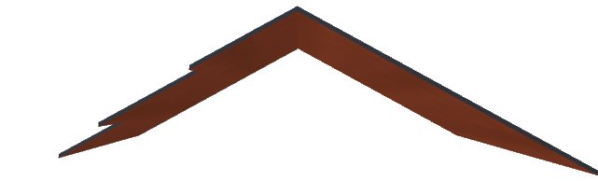
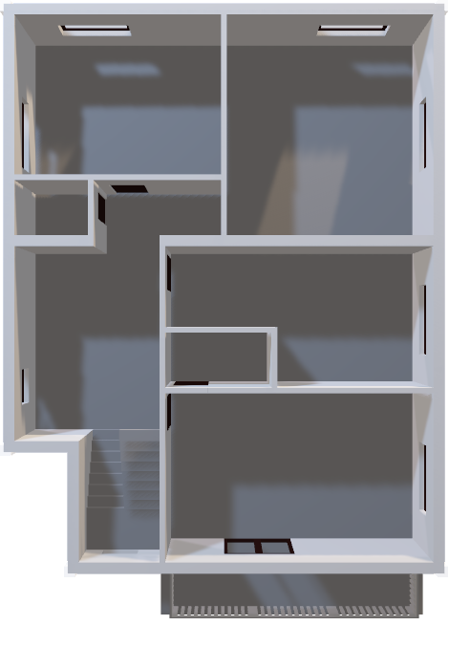
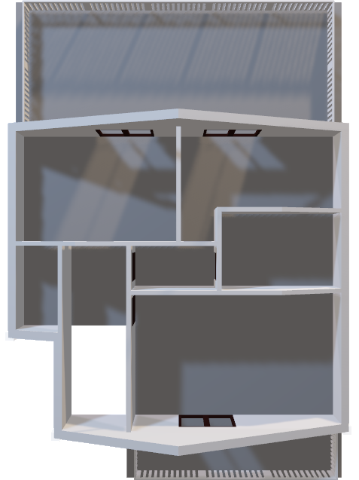
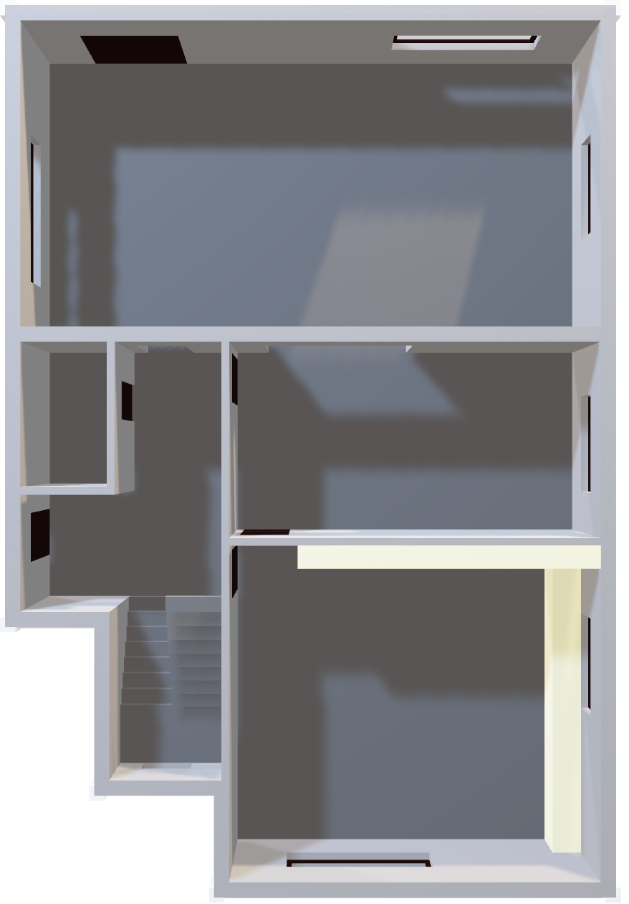
Analysing the data
Roof
This data is from Ames, Iowa. The location is extremely correlated with Sale Price.
With an average house price of $180921, it seems like I should relocated to Iowa!
3rd Floor
2nd Floor

Slide 8
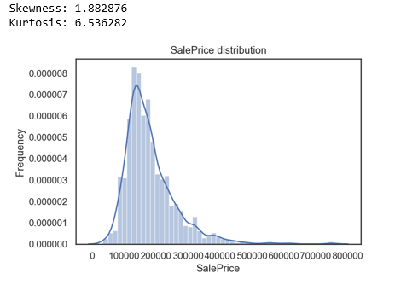
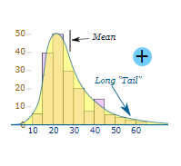
EXPERTLY DESIGNED TO MAKE THE MOST OF EVERY INCH OF SPACE, PROVIDING LUXURY LIVING FOR THE LARGE OR GROWING FAMILY
This distribution is positively skewed.
Notice that the black curve is more deviated towards the right.
It is recommended to fix the skewness to make good decisions by the model.

Slide 9
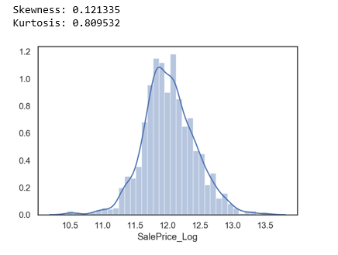
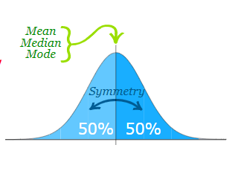
EXPERTLY DESIGNED TO MAKE THE MOST OF EVERY INCH OF SPACE, PROVIDING LUXURY LIVING FOR THE LARGE OR GROWING FAMILY
Okay, So how do I fix the skewness?
The best way to fix it is to perform a log transform of the same data, with the intent to reduce the skewness.
After taking logarithm of the same data the curve seems to be normally
Reading about Log Transformation:
http://fmwww.bc.edu/repec/bocode/t/transint.html distributed

Slide 10
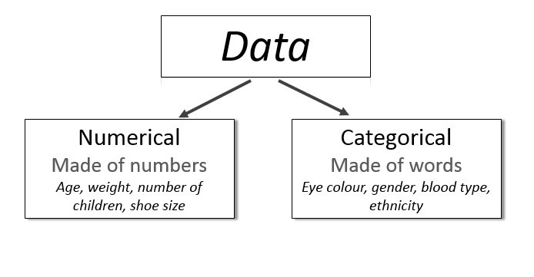
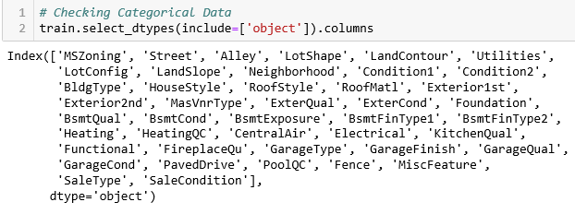
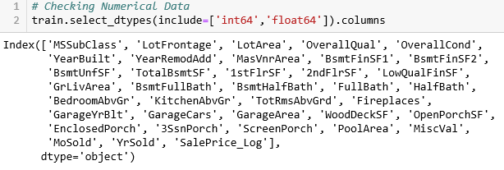

Multivariable Analysis
Identifying Categorical and Numerical variables
43
3rd Floor
2nd Floor
80 Categorical variables
Need to find top 20 features related to sales price, using correlational matrix
37
80

Slide 11
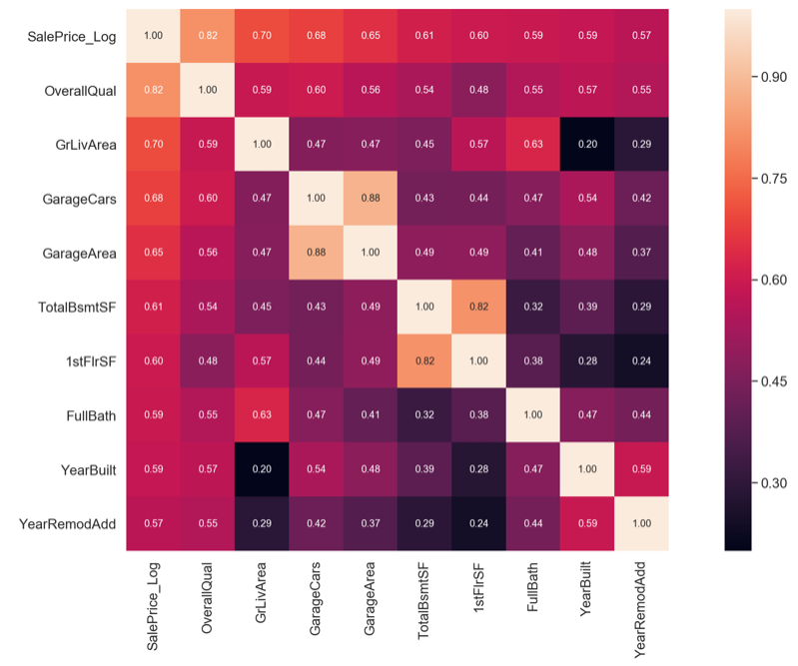
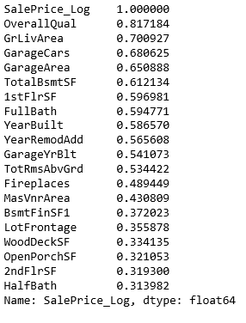
Top 10 factors effecting the house price
Roof
Using Correlational matrix we get the top 10 factors which play a major role in the house price.

Slide 12
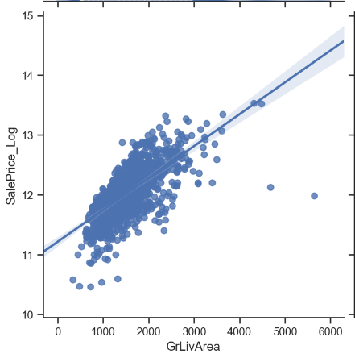
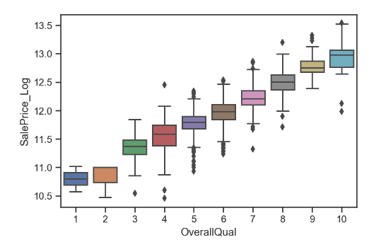
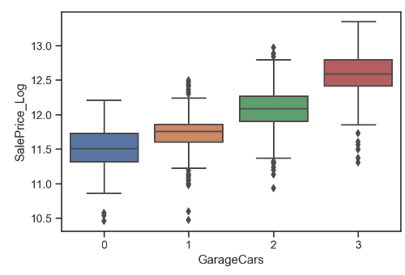
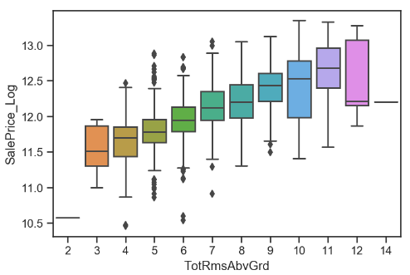
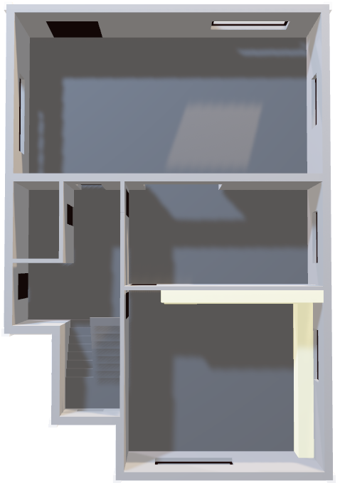
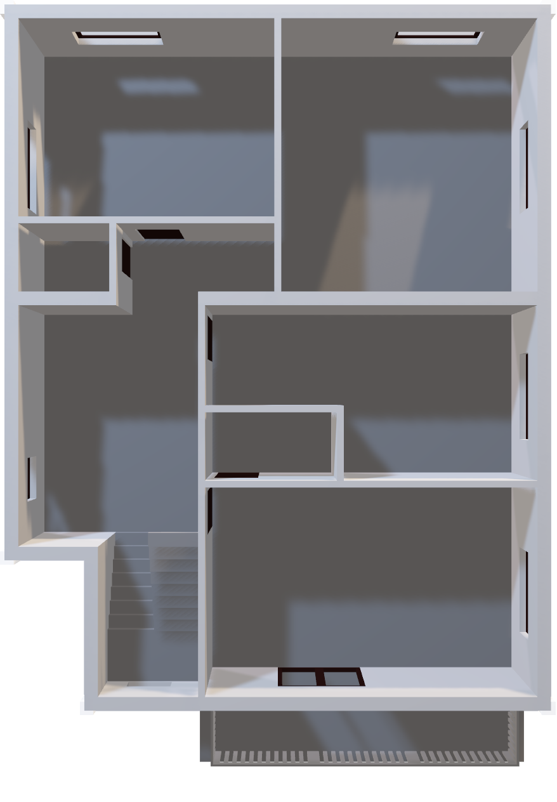

Plotting
Roof
Various plots showing it’s relation with sales price
Identify the outliers and data cleanup by removing the outliers
3rd Floor
1st Floor

Slide 13
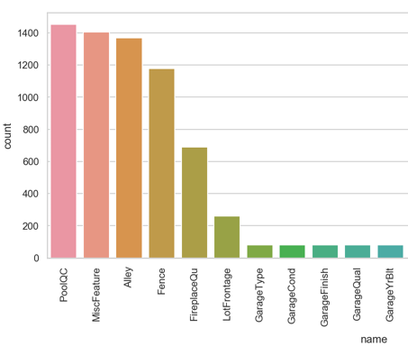
Roof
Transformation and Engineering:
Data Cleanup
How important is the missing data?
How many missing?
Wrong deletion can effect analysis
Start the cleanup for both train and test datasets
Categorical values replace by ‘None’ (where 99% , 50% empty)
Replace non-important with ‘None’
Numerical values – get mean and replace with mean() value
Check end results
Visualize the missing values
Find missing data
Look for null values
How important in correlational level?
3RD FLOOR
2ND FLOOR
1ST FLOOR

Slide 14
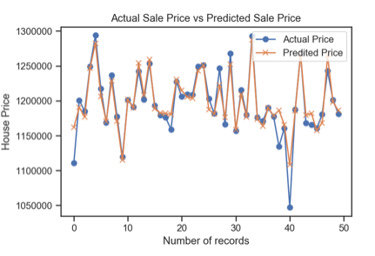
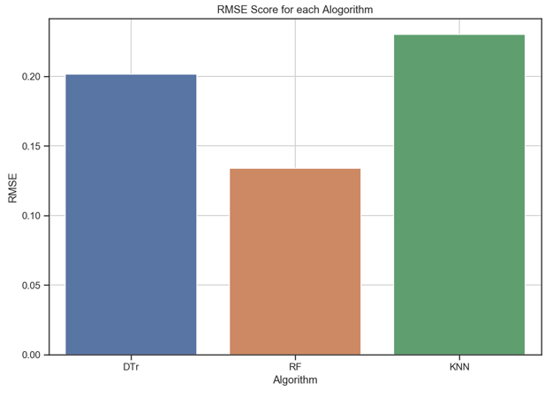
Roof
Modelling and predictions:
Data conversion
Convert categorical data to numeric
Use multiple regression models
Compare results of models
Visualize Prediction Vs Actuals
Random Forest
Decision Tree
K-Nearest Neighbor
3RD
2ND
1ST

Slide 15
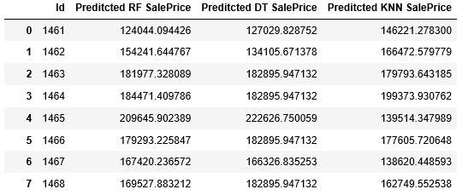
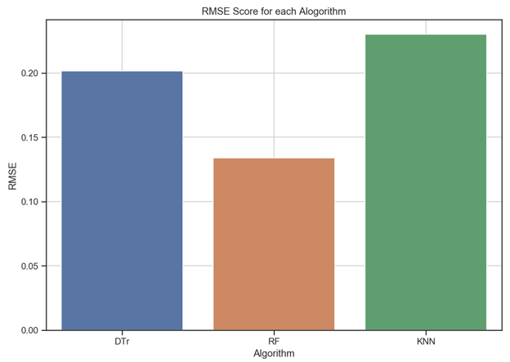
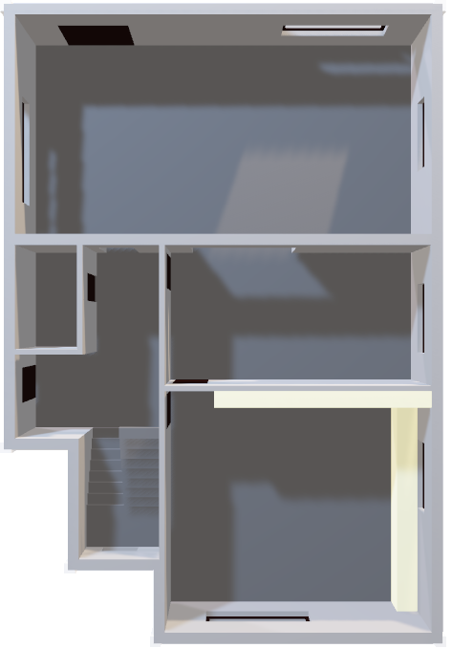
Comparing the predictions
Roof
RMSE – Root Mean square error.
Whereas R-squared is a relative measure of fit, RMSE is an absolute measure of fit. As the square root of a variance, RMSE can be interpreted as the standard deviation of the unexplained variance, and has the useful property of being in the same units as the responsevariable.
Lower values of RMSE indicate better fit.
.
2nd Floor
1st Floor

Slide 16
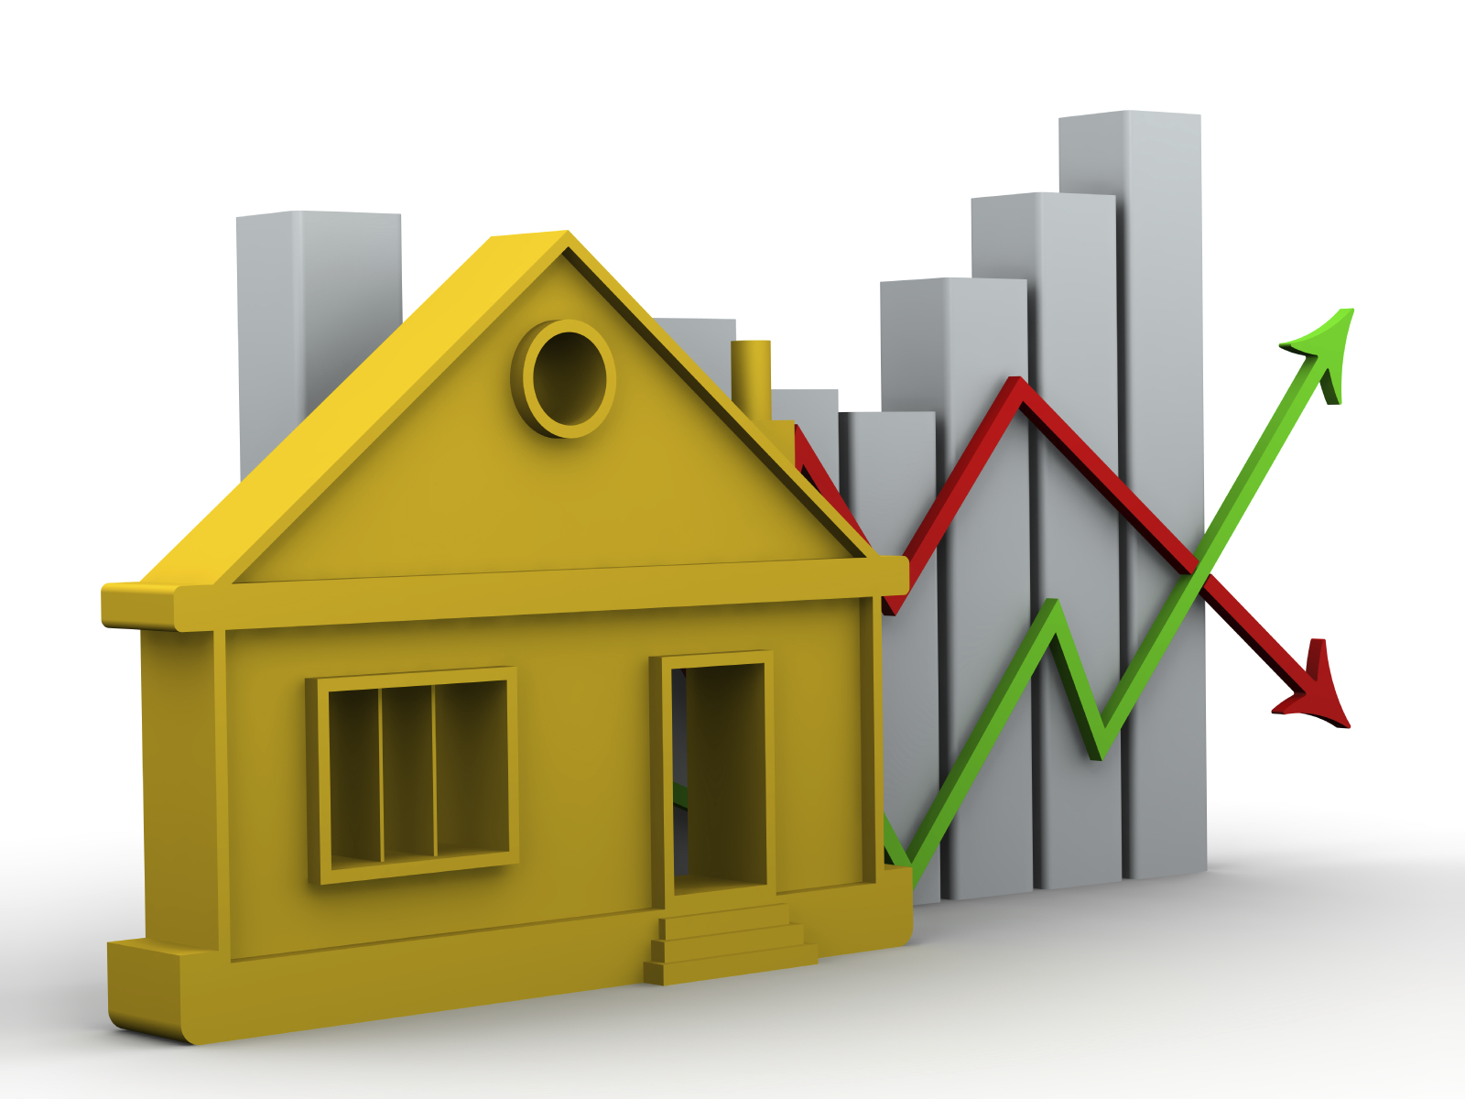
Conclusion
Roof
Looking in to the predictions given by Random Forest, Decision Tree and KNN.
We see that Random Forest Regression has the lowest RMSE value.
We can conclude that, here Random Forest Regression method provides the most accurate home price predictions between the other three in this case.
2nd Floor
1st Floor

Slide 17
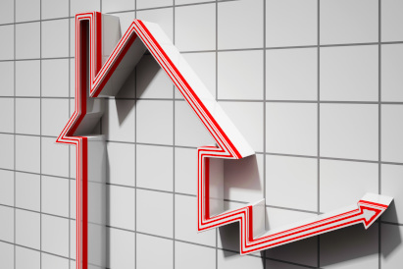
Research
Roof
About Skewed dataset : https://becominghuman.ai/how-to-deal-with-skewed-dataset-in-machine-learning-afd2928011cc
Regression: https://towardsdatascience.com/introduction-to-machine-learning-algorithms-linear-regression-14c4e325882a
Issues faced:
2nd Floor
1st Floor
Understanding Skewed data
Too many characteristics

